Slide 1


Insurance Claims & Prediction
SAMI Muhammad Talha
RELEKAR Akhil (20656087)
RAJPUT Kabir (20560795)

Slide 2

Table of Contents
01
02
03
Motivation
Execution Plan
Data Preprocessing
Why work on the insurance industry
Our approach and timeline to the problem
Initial data collection and required data cleaning
04
05
06
Modelling
Results
Conclusion
Describing various models we tried
The results of our models
Summary of the whole presentation

Slide 3

Motivation
Explore the possibilities of InsureTech in Hong Kong by analysing the trends in data.
We use the latest trends in Data Analytics to explore risk profiling and claims prediction
Notes:
Given the recent approval from the Hong Kong Monetary Authority (HKMA) for virtual banks and the grant from the Insurance Authority (IA) for virtual insurance companies, the business space for the FinTech and InsureTech sector has grown mutli-fold. Companies like Bowtie have raised US$ 30 Million Dollar in series A backed by Sun Life Insurance and has a shareholder base that includes the Hong Kong X Technology Fund and angel Investors. Similarly, Ping An One Connect, the FinTech arm of Ping An Insurance plans to provide the technology to help other financial institutions in the city manage fraud and loan default risks.
Therefore, it is our team’s motivation to be in the intersection of the latest trends in the insurance sector and the tech sector. We plan to leverage our skills developed in the data analytics course in the application of insurance claims predictions. Our secondary goal is to provide risk profiling and recommendation by customer segmentation.
As AI is known to reduce operational costs and increase business efficiency, we believe that our solution would allow companies to save on operational costs and provide tailored profiling

Slide 4
Execution Plan
Focusing on the business problem that our team will target
Sep 19
Oct 19
Find relevant datasets in for the insurance industry
Work on Data Pre-processing and modelling
Nov 19
Dec 19
Report, presentation and conclusion

Slide 5
ML Pipeline
Dataset Collection & Analysis
Modelling, Ensemble, Hyperparameter Tuning
Pre-processing, Normalization & Feature Extraction
Results & Conclusion

Slide 6
Dataset Insights
Health Data
Car Claims Data
Auto Fraud
13 Million values for the car claims dataset
1 Multiple Datasets
2 Dataset Size
3 Why Multiple Datasets?
4 Dataset Variables
Cover the whole insurance pipeline, from profiling for price to claims prediction to fraud detection
Variables like age, bmi, smoker, charges for DS1 Car Model, Purchase Date for DS2 Claim amount, model name for DS3

Slide 7
Data Pre-processing
Raw Data --[transformation]--> Useful Input

Slide 8
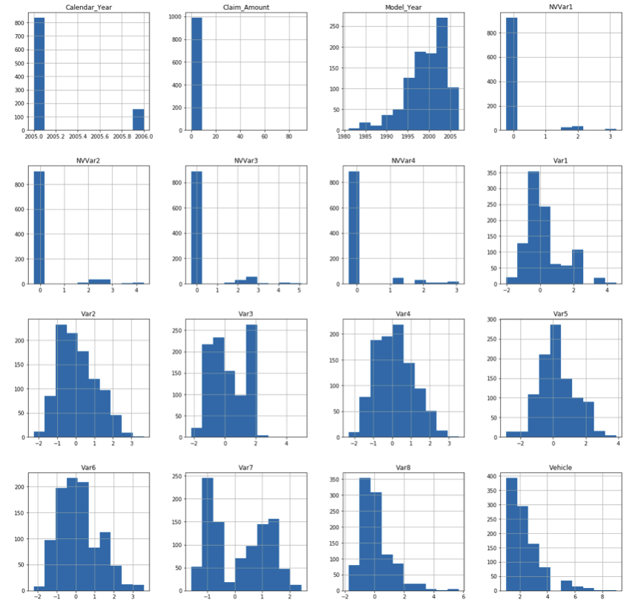
Analysis using visual exploration of data

Slide 9
Overview of Data Preprocessing
OUTLIERS
CATEGORICAL VARIABLES
IMPUTATION
Interquartile range was used to find and remove outliers
Categorical variables were one-hot encoded using dummy variables
We deleted columns and rows that had null values over a threshold of 90%

Slide 10
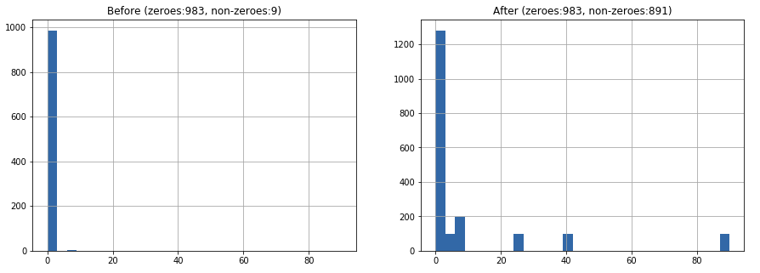
Oversampling
Remove the bias in model’s prediction by providing balanced dataset
Target column: Claim_Amount

Slide 11
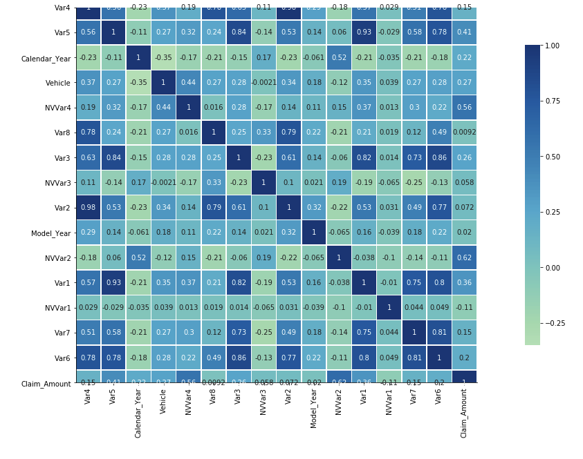
Feature Selection
Reduce the complexity of model
Reduces overfitting
Enables Machine Learning Algo to train faster
Top 2 features:
NVVar2
NVVar4

Slide 12
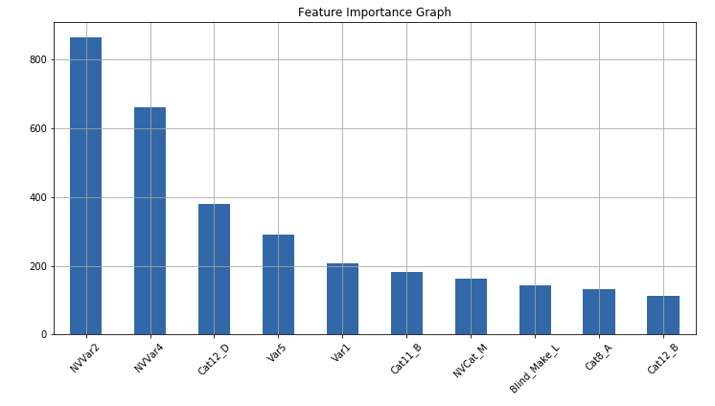
Feature Selection using Filter Method
Picks the intrinsic properties of the features (“relevance” as per target feature) measured via univariate statistics
Using SelectKBest features with f_regression as scoring function
Top 2 features:
NVVar2
NVVar4

Slide 13
Pre-Modelling
Train/Test Split
Normalization
Cross Validation
Notes:
You need to explain us the method you are using, and why do you think it works well on your specific problem, and properly present your results.

Slide 14
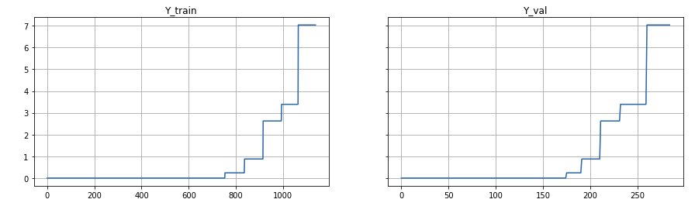
Train/Test Split
80/20 split
Split has been done with the help of ‘train_test_split’ function in the sklearn.model_selection package
Shuffled, randomized and balanced

Slide 15
Normalization
Cross-Validation
Min-Max Scaler
Bounded values
Preserves the shape of the original distribution
Kfold Cross Validation:
10 folds
Scoring: ‘neg_mean_squared_error’

Slide 16

Analyzing
the
Models
Which models have the highest predictive power in InsureTech?
Notes:
Now, we shall talk about the different models we experimented with for the different use cases that we were trying to address.

Slide 17
Modelling
Decision Tree
Random Forest
Extra Trees
XGBoost
Notes:
We made use of Decision Trees, ExtraTree and ExtraTrees regressors, Random Forests, K Neigbor regressors, AdaBoost, and XGBoost. In this presentation, we will focus on the 4 models we have more success with overall, which are Decision Trees, Random Forests, Extra Trees and XGBoost.

Slide 18
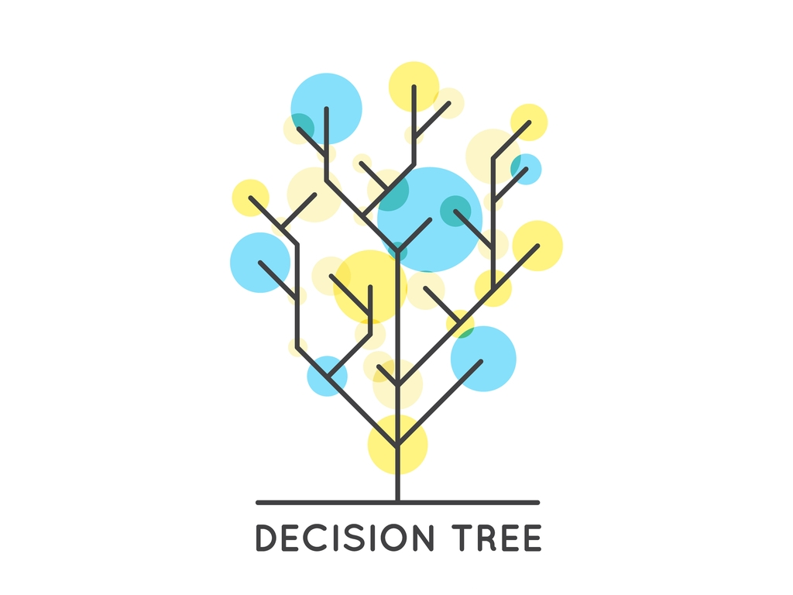
Decision Trees
Split the data recursively until you can predict successfully
Splitting is done on the basis of a pre-selected information criterion, e.g. maximization of decrease in Entropy
Notes:
Decision Trees is a model where we split the feature vector recursively, selecting a binary (Yes/No) at every level, until we can predict the label or the regression result. The splitting in decision trees is usually based on information gain, which is defined as the loss of entropy between successive levels of the tree.

Slide 19
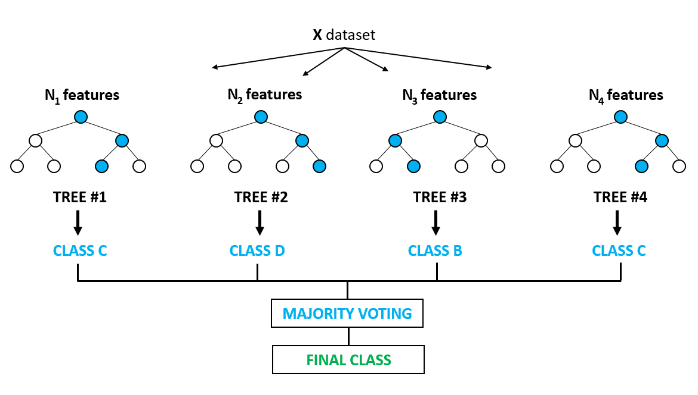
Random Forest Regressor
Decision Trees can be prone to overfitting
One way of reducing variance: training different trees on different subsets of data and bagging the resultant forest
Notes:
Decision trees tend to overfit on the sample data. One way of overcoming that is by creating different decision trees on different subsamples of data, and then aggregating them through an averaging/voting mechanism. This kind of model is referred to as Random Forest Regressor.

Slide 20
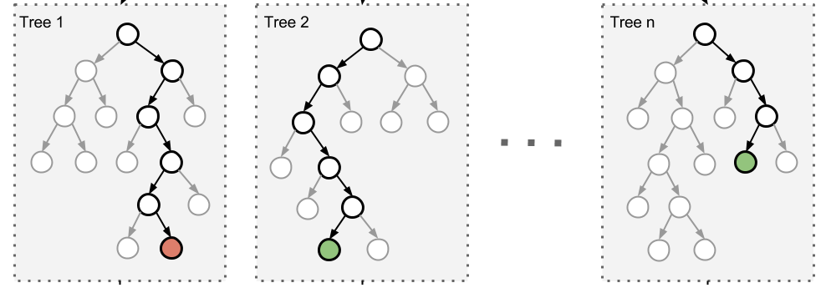
Extra Trees Regressor
Variance can be further reduced by splitting the trees randomly, instead of on a pre-selected information metric
Notes:
One model which takes this spirit of reducing variance even further is ExtraTrees regressor, which works in a similar way as Random Forests, but splits each tree randomly instead on a preselected information gain metric.

Slide 21
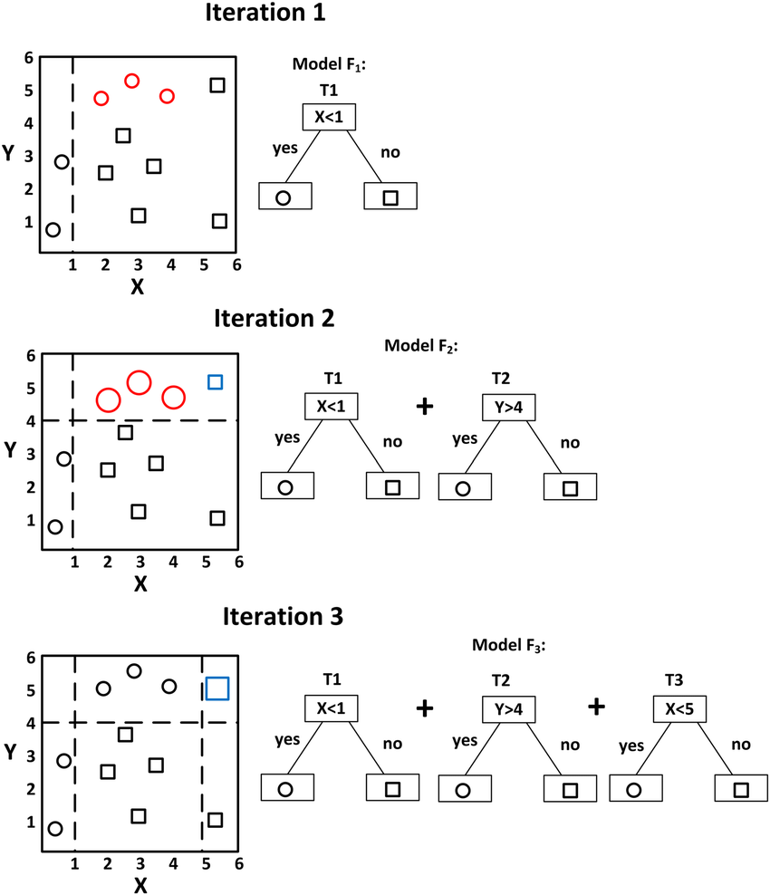
XGBoost
Add trees that minimizes a “loss” function
Parameterize the trees and use gradient descent to find the set of parameters for the new trees
Notes:
In XGBoost, a gradient descent procedure is used to minimize the loss when adding trees.
Traditionally, gradient descent is used to minimize a set of parameters, such as the coefficients in a regression equation or weights in a neural network. After calculating error or loss, the weights are updated to minimize that error.
Instead of parameters, we have weak learner sub-models or more specifically decision trees. After calculating the loss, to perform the gradient descent procedure, we must add a tree to the model that reduces the loss (i.e. follow the gradient). We do this by parameterizing the tree, then modifying the parameters of the tree and moving the right direction by (reducing the residual loss).

Slide 22
Why these Models
What Objective Function? RMSE
...
Why Tree Regressors?
Decision boundary stepping across many variables
What models worked best? Decision Trees for Fraud Detection Random Forest Regressor for Claim Regression Extra Trees for Claim Classification
…..
Notes:
Having explained a few of the major models we made use of, let’s revisit why we chose these models for our use cases in the first place. One of the major reasons we used regression models that require feature selection instead of deep models was that for two of our three use cases, we did not have very large samples of data. Besides, the features that were important for our predictions were often intuitively available.
This was also one of the reasons we chose the tree regressors, as we expect the actual generative models in our use cases to have step-function-like boundary surfaces.
In all our models, we used Root Mean Squared Error as our objective function. This consistency allowed us to compare model performance easily.
The models that worked best in our analysis were: Decision Trees for Fraud Detection Random Forest Regressor for Claim Regression, and Extra Trees for Claim Classification

Slide 23
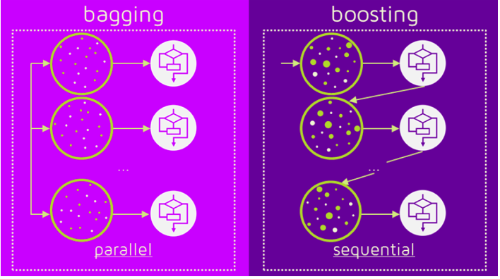
Ensemble Methods
Bagging
Boosting
Combining models trained on “bags” of data
Weighing up the hard-to-classify cases
Reduces variance
Reduces bias
Notes:
Since most of our models exhibited some of these characteristics, I would like to touch upon them briefly.
Bagging is the technique whereby models are bootstrapped first by training them on subsets of data, and then aggregated through an averaging or pooling mechanism in case of regression or a voting mechanism in case of classification. This helps reduce variance of the sample on which the model is being trained. Boosting is the technique where successive models are trained after increasing weights of examples that were misclassified or regressed with high residuals. This helps reduce bias of the training data.

Slide 24
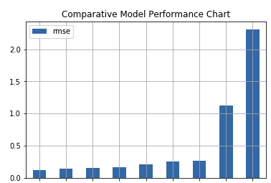
Model Results
Taking Claim Regression as Example
TOP 3 Picks
A | ExtraTrees
B | AdaBoost
C | Bagging
ExtraTreesRegressor
AdaBoostRegressor
BaggingRegressor
Notes:
Now I would like to show you comparative performance of some of our models on the use case of Total Claim prediction. As you can notice, ExtraTreeRegressor, AdaBoost and BaggingRegressors worked the best in that case.

Slide 25
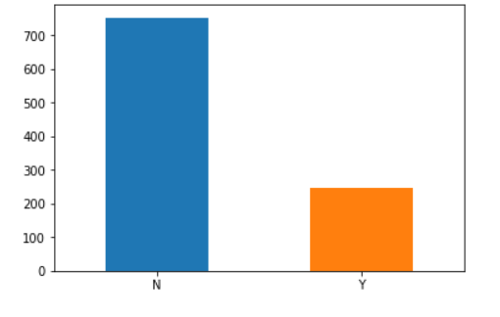
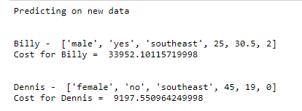
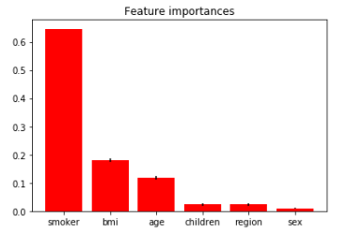
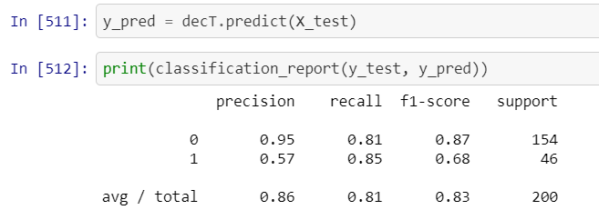
Results
Risk Profiling - Pricing Insurance
Fraud Cases
Notes:
This slide shows the results that we obtained on the Claim Classification and Fraud Detection problems. Notably, we achieved a precision of 95% on the Fraud Cases with Decision Trees.

Slide 26

Conclusion
Notes:
Moving on to the conclusion...

Slide 27
Outcome
Operational
Risk
Operational cost saving
Risk Profiling
Trends
Marketing
Customization
Accurate prediction
Product marketing - recommendation
Customer Segmentation - Tailored Profiling
Notes:
Through this project, we have been able to ascertain that the power of data analytics and machine learning can be used for making accurate predictions about claims and for detection of fraud in the Insurance industry.
This can lead to operational efficiency - cost savings for the insurance companies, and more tailored products for the consumers, more tailored and recommendation-based product marketing, and customer segmentation based on data-backed risk profiling.

Slide 28
$4,000,000,000,000+
*Total value annually lost by corporations due to fraud Data can change that
Notes:
Finally, some food for though:. Every year, corporations around the world lose 4 trillion US Dollars worth of value at the hands of Fraud. Just tackling this one case through smart data analytics can create immense value for companies and consumers.

Slide 29


Thank You!
Notes:
Thank you very much for your time!

Slide 30
Appendix
Health Based
https://github.com/KabirRajput/Insurance-Cost-Analysis/blob/master/Health%20Care%20Cost%20Analysys_Prediction%20Python.ipynb
Car Claims
https://www.kaggle.com/c/ClaimPredictionChallenge/data
Fraud
https://www.finance-monthly.com/2018/07/fraud-epidemic-costs-3-2-trillion-globally/
https://blog.usejournal.com/using-a-data-pipeline-to-predict-insurance-claim-fraud-6f8e85367294
Notes:
Here are the references to the datapoints we mentioned and the datasets we used.

Slide 31



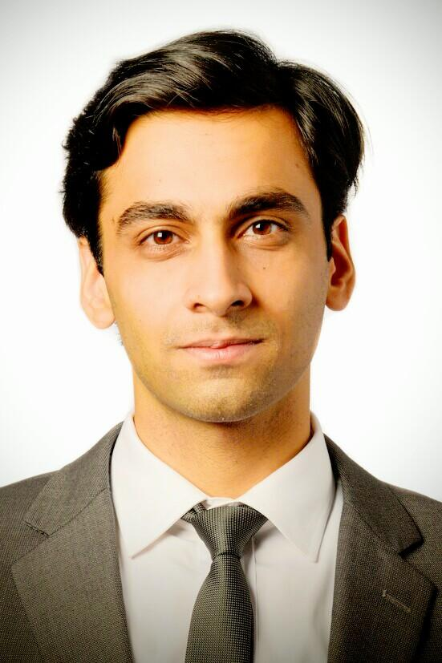
Our Team
Akhil Relekar
Data collection, Modelling, Presentation, Report
Kabir Rajput
Akhil Relekar
Talha Sami
Data collection & Pre-processing, Modelling, Presentation, Report
Data collection & Pre-processing, Modelling, Presentation, Report
Data collection & Pre-processing, Modelling, Presentation, Report
Notes:
Hope you liked the presentation!

